Slide 1
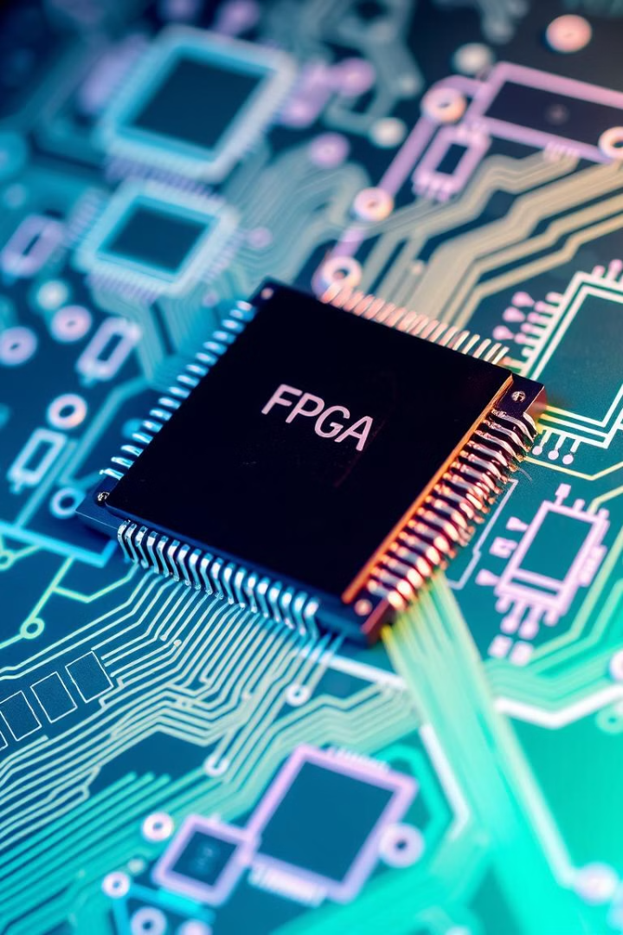

Designing a Memory Controller Using Automata Theory in FPGA
Leveraging the power of automata theory, this presentation explores the process of designing a robust and efficient memory controller for Field Programmable Gate Arrays (FPGAs). By understanding the fundamentals of finite state machines, we can develop a memory controller that optimizes performance and power efficiency.
by Satyam Srivastava

Slide 2
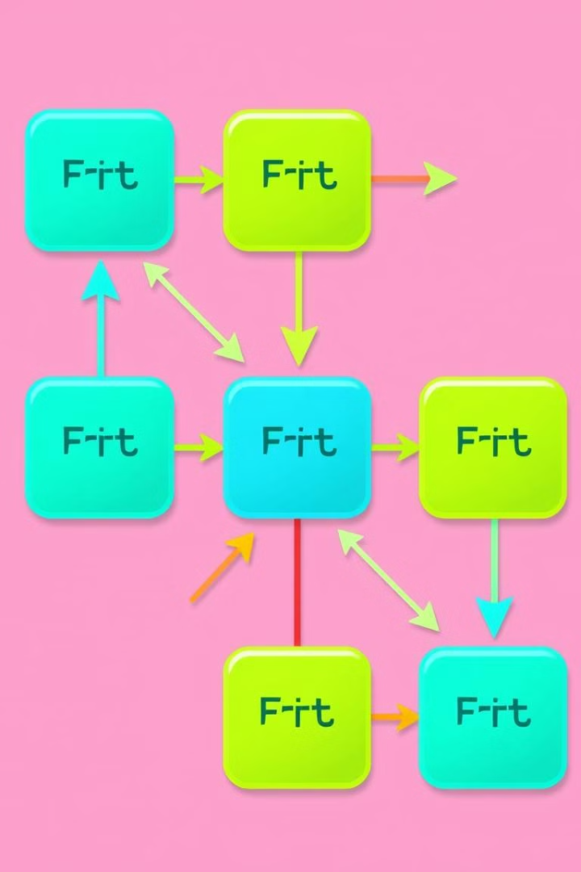
Introduction to Automata Theory
1
Deterministic Finite Automata
2
Modeling Complex Systems
The core concept of automata theory, defining a machine with a finite number of states and well-defined transitions.
Automata theory provides a mathematical framework to model and analyze the behavior of complex systems, such as memory controllers.
3
Formal Verification
Automata-based models enable rigorous formal verification, ensuring the correctness and reliability of the memory controller design.

Slide 3
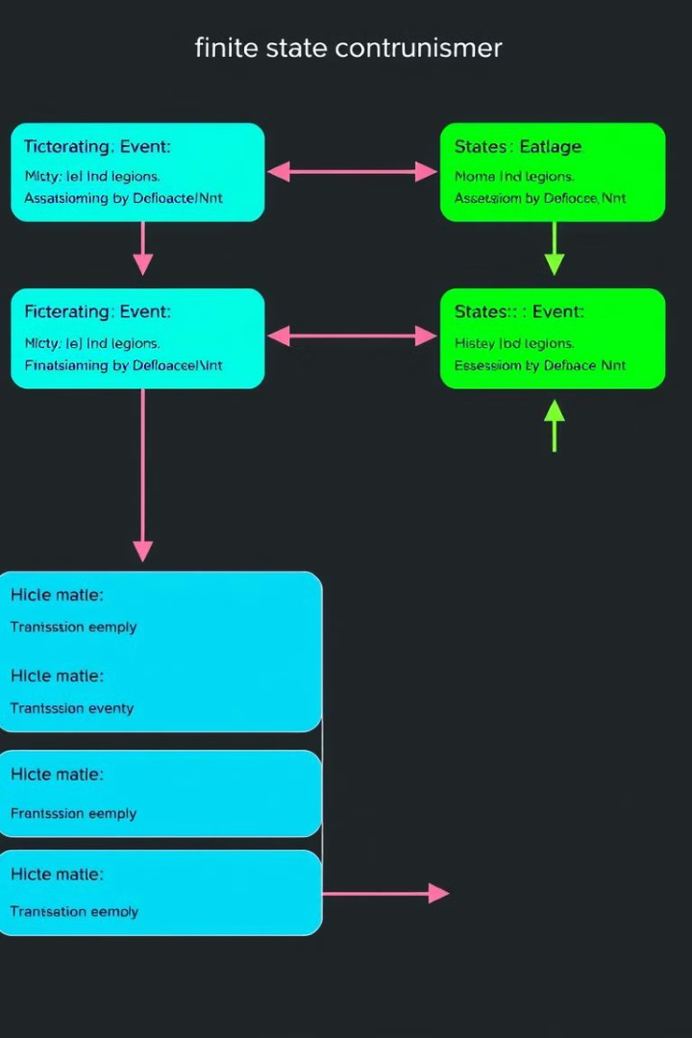
Finite State Machines and Memory Controllers
1
Read Operation
The finite state machine manages the sequence of steps to perform a memory read, such as address decoding, data retrieval, and handshaking.
2
Write Operation
The finite state machine coordinates the write process, including address selection, data buffering, and write confirmation.
3
Refresh Cycles
For dynamic memory technologies, the finite state machine ensures periodic refresh cycles to maintain data integrity.

Slide 4
Memory Controller Design Considerations
Timing Constraints
Memory Interface
Error Handling
Adhering to strict timing requirements, such as read/write timings, row/column access, and memory refresh intervals.
Supporting a variety of memory technologies, including SRAM, DRAM, and emerging memory types, with appropriate control signals.
Implementing robust error detection and correction mechanisms to ensure data integrity in the memory subsystem.

Slide 5
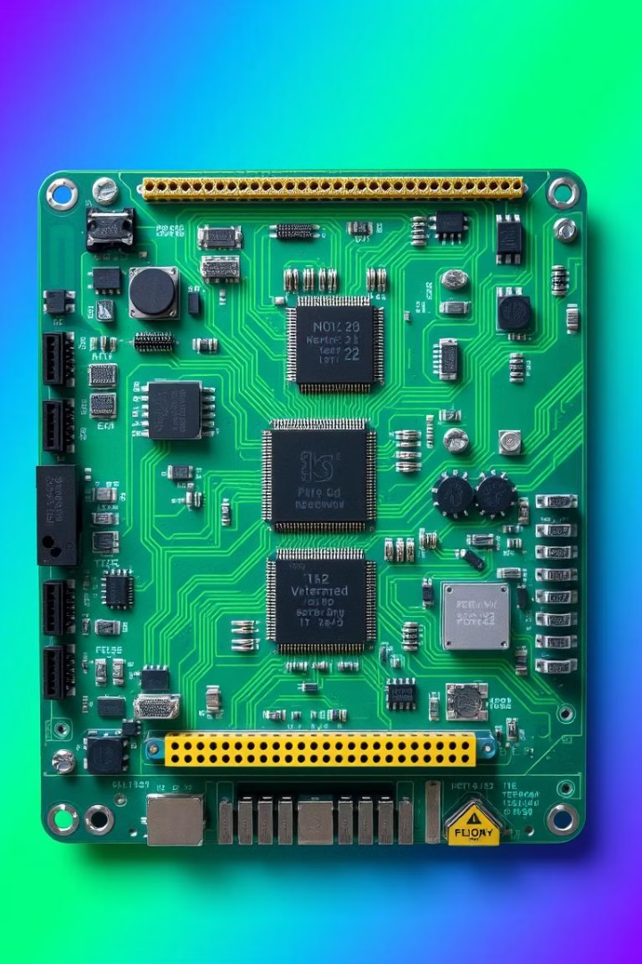



Implementing a Memory Controller Using FPGA
Hardware Description
Translating the automata-based design into a hardware description language, such as Verilog or VHDL, for FPGA implementation.
FPGA Synthesis
Synthesizing the HDL code into a bitstream that can be programmed onto the FPGA device.
Hardware Verification
Rigorously testing the memory controller implementation on the FPGA to ensure correct functionality and timing.

Slide 6
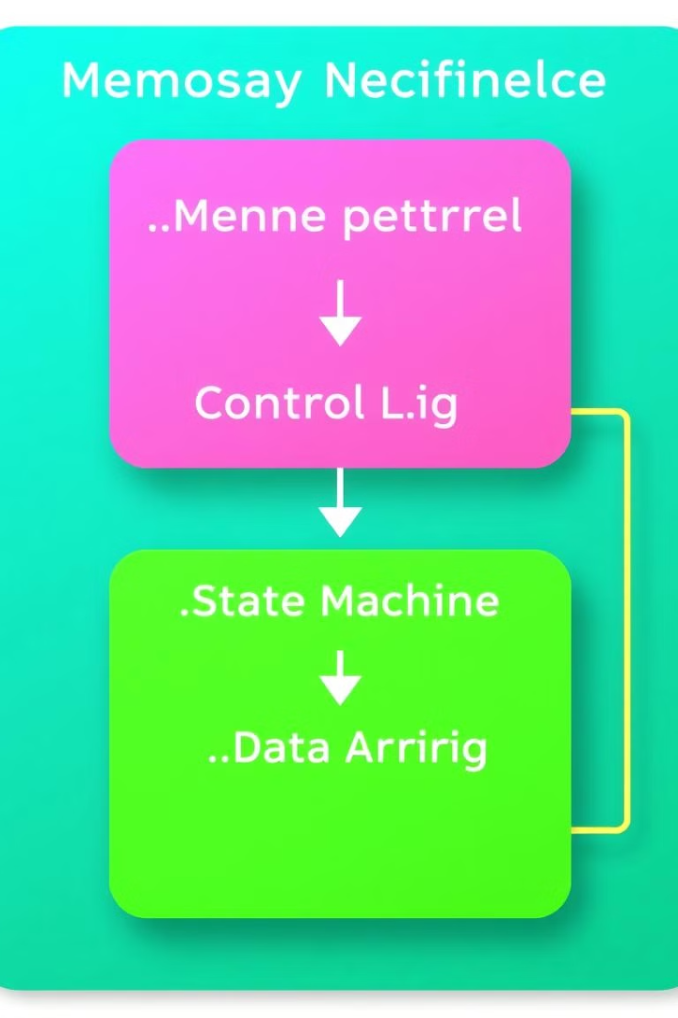
Automata-based Memory Controller Architecture
Control Logic
Memory Interface
The finite state machine that manages the memory access protocols and timing sequences.
The logical and physical connection to the memory devices, handling address, data, and control signals.
Arbitration
Buffering
Mechanisms to handle multiple memory access requests and ensure fairness and prioritization.
Efficient data buffering to bridge the speed mismatch between the processor and memory devices.

Slide 7
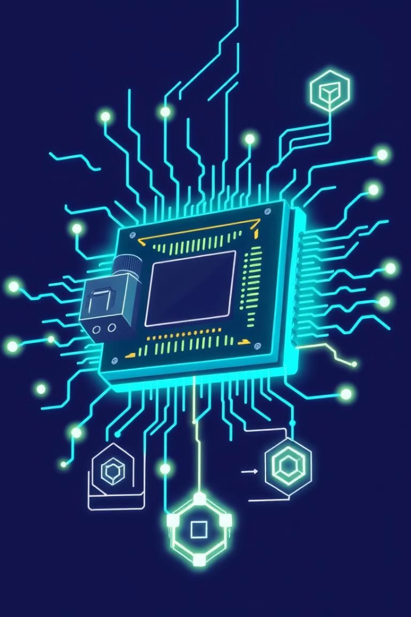



Verification and Debugging Techniques
Testbench
Comprehensive testbenches to thoroughly exercise the memory controller's functionality and edge cases.
Debugging
Leveraging FPGA debugging tools and techniques to identify and resolve issues in the memory controller design.
Formal Verification
Applying formal verification methods to mathematically prove the correctness of the memory controller's behavior.

Slide 8
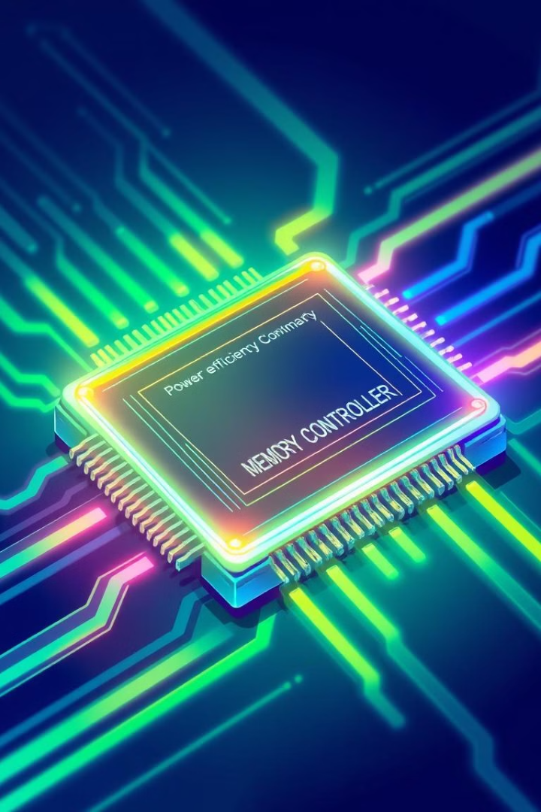
Optimizing Performance and Power Efficiency
Memory Bandwidth
Maximizing the data transfer rate between the memory controller and memory devices.
Latency Reduction
Minimizing the time between a memory access request and the completion of the operation.
Power Management
Implementing dynamic power-saving modes and clock gating to reduce energy consumption.

Slide 9

Conclusion and Future Directions
By applying automata theory to the design of memory controllers for FPGAs, we can create robust, efficient, and verifiable solutions that meet the ever-increasing demands of modern computing systems. As memory technologies continue to evolve, this approach will remain crucial for adapting and optimizing memory subsystems.

